Slide 1
SENTECH SHORTWAVE SERVICES:
Communicating with Africa
HFCC B15 – Brisbane - August 2015

Slide 2

INDEX
Sentech Overview
Industry Outlook
Sentech SW Services
Available Timeslots
FTP
DRM
Digital Radio Trials
SW Market Research
SW Strategy
Hosting HFCC B 17

Slide 3
SENTECH OVERVIEW
Sentech is a state-owned company with the South African government as the sole shareholder
Our vision is “To be a world-class provider of a sustainable communications network infrastructure and services in Africa”
Sentech connects its stakeholders to their world and connects the world to them through a wide range of communication solutions
We provide the sounds of radio and the pictures of television, and offer internet connectivity from anywhere, connecting customers to those overseas and providing virtual private networks for businesses on one integrated network
Broadcasting & Media
Terrestrial TV
Telecommunication Services
Other Services
Facility Rental
VSAT
Wireless Broadband
Terrestrial Radio
Free To Air Satellite TV & Radio
Business TV & Radio
Content Management Solutions
Training
Consulting

Slide 4

SW IN AFRICA: INDUSTRY OUTLOOK
SW in Africa
A reported 20 - 30 million SW listeners
Works where there is no FM coverage
Works where there is no MW coverage
Works where there is no TV coverage
Works where people don’t have Internet access
Works across country borders
Used to educate, inform, entertain in local languages
Affordable receivers

Slide 5
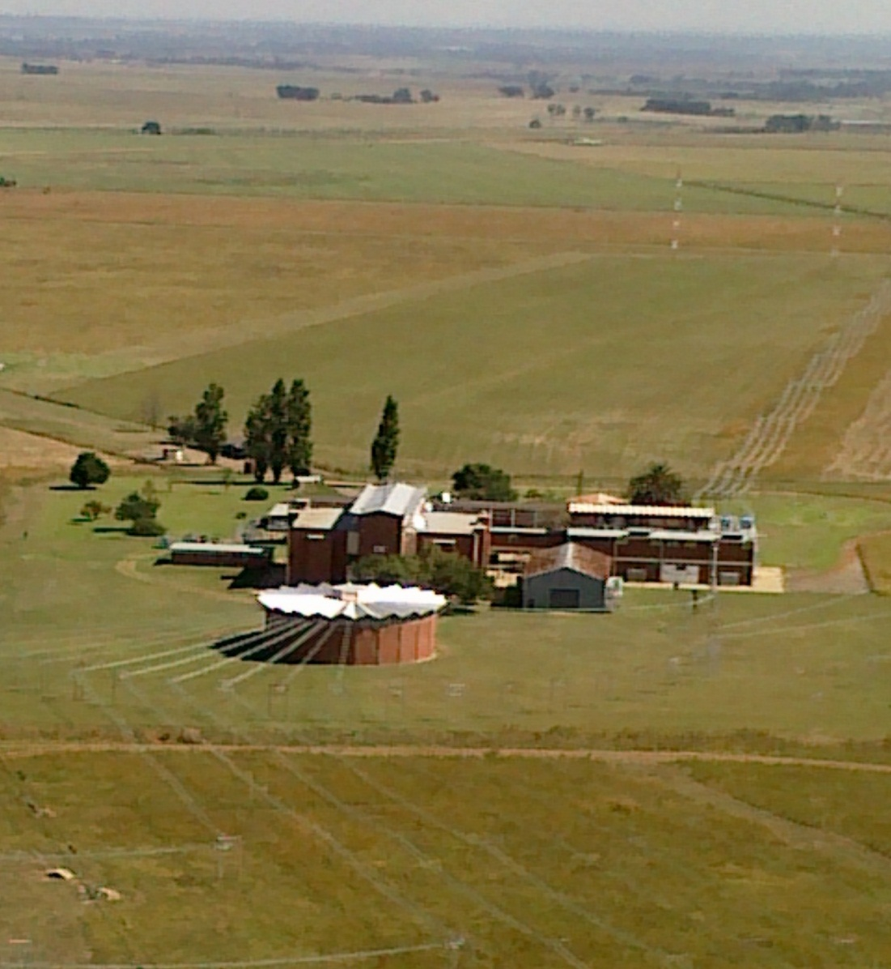
SW INFRASTRUCTURE
Established
1964 in Meyerton in Gauteng, South Africa
Short Wave Infrastructure
11 SW transmitters
  7 x 100 kW
  4 x 250 kW
43 Antennae
Broadcast Hours
2 300 hours per month to
  9 different SW Broadcasters across Africa

Slide 6

LINKING & TECHNICAL SUPPORT
Linking
  Satellite (C-band and Ku-band)
  Digital leased lines
  Radio microwave links
  FTP
Technical Support
  20/7 manned SW station
  24/7 NOC
  Toll-free contact number
  SLA to 3rd level support
  +99.5% transmitter availability
  21 highly trained staff at Meyerton

Slide 7





AVAILABLE TIMESLOTS
Transmitter Availability B15 - Meyerton, South Africa
Please note that tables below give an overall indication of transmitter availability in Meyerton South Africa
Available capacity is still dependent on specific transmission requirements.
Start UTC | End UTC | Power | Transmitters Available | Target Area
00:00 | 05:00 | 250 kW | 1 | North, East, West, Central Africa & Middle East
07:30 | 14:00 | 250 kW | 2 | North, East, West, Central Africa & Middle East
15:00 | 17:00 | 250 kW | 1 | North, East, West, Central Africa & Middle East
19:00 | 00:00 | 250 kW | 2 | North, East, West, Central Africa & Middle East
00:00 | 15:00 | 100 kWE | 1 | North, East, West, Central Africa & Middle East
18:00 | 00:00 | 100 kWE | 1 | North, East, West, Central Africa & Middle East
03:00 | 05:00 | 100 kWE | 2 | North, East, West, Central Africa & Middle East
15:00 | 16:00 | 100 kWE | 2 | North, East, West, Central Africa & Middle East
17:00 | 20:00 | 100 kWE | 2 | North, East, West, Central Africa & Middle East
00:00 | 05:00 | 100 kW | 2 | Southern Africa
08:00 | 16:00 | 100 kW | 2 | Southern Africa
17:30 | 00:00 | 100 kW | 2 | Southern Africa
Sentech contacts
Sikander Hoosen +27 72 019 2877
Steven Tshehla +27 82 261 8381

Slide 8

FTP SERVICES
FTP can serve as a quick and inexpensive way of down-loading recorded audio onto a server from where it can be scheduled for play-out on the appropriate transmitter at the appropriate time. It can also act as backup for improved network connectivity when a live feed fails
Customer Server
Hosting of customer FTP server
Sentech will provide:
Full play-out service via internet (128kbps) & routing of customer feed to the customer FTP server
Manual and automated audio switching in line with the customer broadcast schedule
Infrastructure for hosting of the customer FTP server at Meyerton
Monitoring and 1st-line maintenance of the customer server
The customer will be charged for equipment hosting only (includes 1st line support) and the associated Internet and linking costs
Sentech Server
Sentech owned Play-out solution, including FTP server
Sentech will provide:
Full play-out service via internet (128kbps) including FTP URL for customer upload
Manual and automated audio switching in line with the customer broadcast schedule
Full 24/7 network and server monitoring and support
The customer will be charged for the full use of the Sentech Play-out service and associated Internet and linking costs

Slide 9

SW DRM
Benefits of SW DRM
superior sound quality compared with a SW analogue broadcast
reception of short video clips, slide shows and pictures over a SW transmission medium
the use of scrolling text over a SW transmission medium
special DRM features, such as the emergency broadcast
listener ease of use (no manual tuning required)
two DRM services may be provided on one SW frequency
for the same area of coverage, DRM transmission requires a far lower transmitter power than analogue SW
for the same coverage area, DRM transmission is more cost-effective than analogue transmission due to lower energy costs
suitable for use as a long-distance linking service

Slide 10
DIGITAL RADIO TRIALS
MW DRM
Trial being conducted with Radio Pulpit
Sentech sponsors low-profile professional antenna and part of operational costs
10 kW transmitter with 2 audio services with data
Locally manufactured and USA manufactured antennas
SW DRM
Trials will be conducted with Channel Africa
Sentech will sponsor infrastructure and operational costs
Local trial SA only using NVI antenna with single audio service with data
Africa trial using high gain antenna covering East Africa with 2 audio services with data
Single 50 kW DRM transmitter used for both trials
DAB+
Trial being conducted with NAB members; NAB members responsible for receivers, marketing
Sentech sponsors infrastructure and operational costs
10 kW VHF transmitter at each of Pretoria and Johannesburg in SFN configuration
Front-end in Johannesburg, E1 link to Pretoria
14 services at 80 kbps each

Slide 11

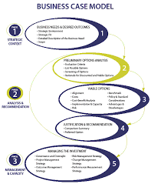
MARKET RESEARCH
SW Analogue Replacement Technologies
Assess uptake and growth of alternative digital radio technologies (DAB+, DRM, DRM+, Internet etc.) – trends across the continent
Assess positioning of SW in the context of alternate digital technologies
SW Analogue market in Africa
Current state of market – growing/stagnant/declining
Readiness to convert from analogue to digital (appetite for DRM)
SW Digital market in Africa
Current DRM broadcasts – trials/commercial
Availability and cost of DRM receivers
Listeners’ knowledge of the benefits of DRM
Listeners’ willingness/ability to migrate to DRM
Assess and analyse SW DRM business and tariff models

Slide 12
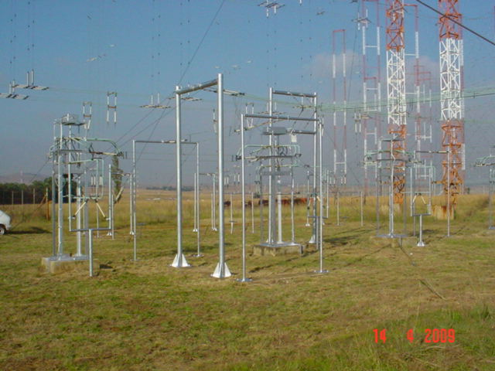
SW BUSINESS STRATEGY
SW Analogue
Maintain and grow current SW analogue services
Rationalise SW analogue services
based on market demand
Eventually exit SW analogue market
SW Digital
Conduct SW DRM trials
Provide commercial DRM services
Grow SW DRM services

Slide 13


HOSTING HFCC B17
Preliminary Planning
Venue: Cape Town or Johannesburg
Quality, affordable conference facilities
Demonstration of DRM services from studio to receiver
Local sightseeing

Slide 14
THANK YOU

