Slide 1

Radio Australia
Presented by Gary Baxter
ABC Communications Networks Division – August 2015

Slide 2
Radio Australia
9 other Divisions
Chief Operating Officer
Technology
Finance
Communications Networks
Managing
Director
ABC Board
Radio
5 National networks
Television
5 National channels
ABC International
Digital
AustraliaPlus.com
AustraliaPlus.cn
Television
Australia Plus TV
Radio
Radio Australia
Simplified ABC
Divisional Structure
Transmission Service Provider
Owns & operates Transmission Infrastructure
Not just
Shortwave Radio!
Manages relationship with Transmission Service Provider
Regulatory compliance / licensing
Frequency Management and coordination

Slide 3
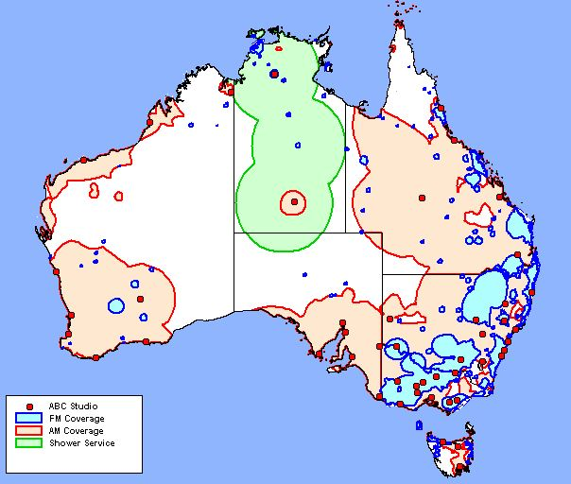
Radio Australia
ABC Domestic Shortwave Services
3 x 50 kW Near Vertical Incident Skywave (NVIS) services provide wide area coverage to remote areas of Australia’s Northern Territory and parts of Western Australia – the ABC Outback Radio service.
Location | Call-sign | Frequency
Katherine | VL8K | Day: 5025 kHz
 |  | Night: 2485 kHz
Tennant Creek | VL8T | Day: 4910 kHz
 |  | Night: 2325 kHz
Alice Springs | VL8A | Day: 4835 kHz
 |  | Night: 4835 kHz

Slide 4
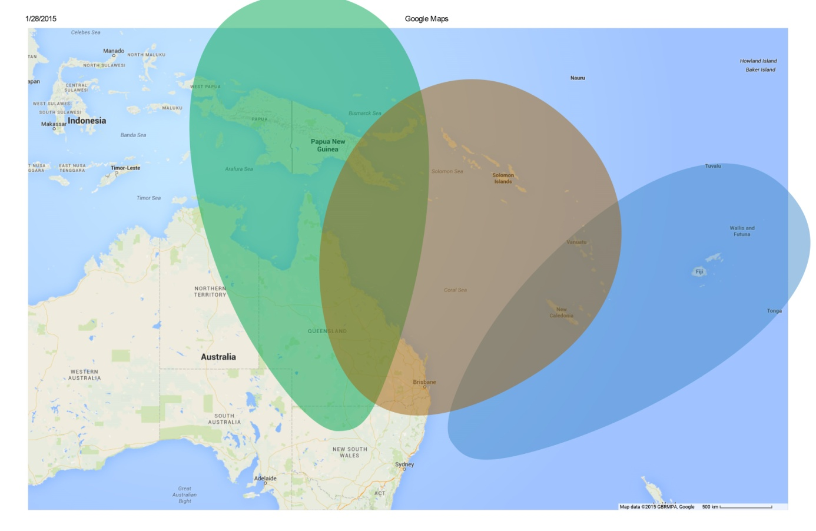
Radio Australia
Overview of ABC International Services
Shortwave - 72 hours per day of Radio Australia shortwave transmission, in three languages, from one transmitting station (Shepparton). 100 kW Services targeting the Pacific region.

Slide 5
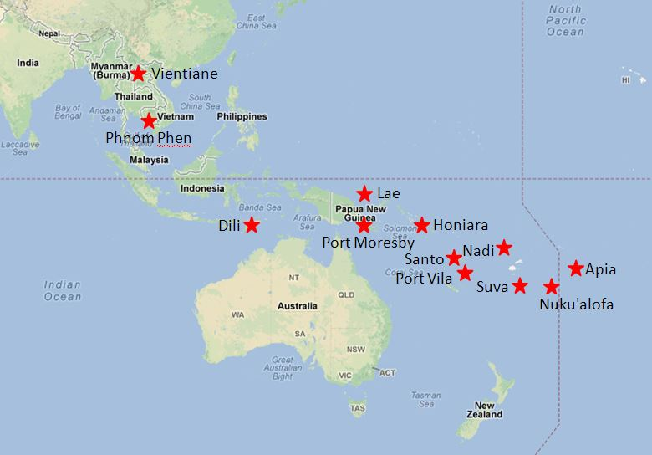
Radio Australia
Overview of ABC International Services – continued
Local radio re-broadcast services - 12 FM relay transmitters located in 9 countries throughout Asia & the Pacific carrying one of two streams Pacific: English/French/Tok Pisin or Asia: English/Khmer/Burmese.

Slide 6
Radio Australia
Overview of ABC International Services – continued
Television – Australia Plus TV is re-broadcast by approximately 95 partner stations (subscription and free-to-air) across Asia and the Pacific.
Satellite – Australia Plus television and Radio Australia are distributed together across the Pacific, south-east Asia, north Asia and south Asia on the Intelsat 18, and Intelsat 20 satellites. This provides a direct-to-home (DTH) service across the region and also provides distribution to the re-broadcast partners.
2 Online streams one English only and one Multi-language: Eng/French/Tok Pisin/Khmer/Burmese.
Syndication of radio content, website stories and video content across a large number of partner stations.
Access to content via several mobile phone Apps.
International development team providing training and support to broadcasters across Asia and the Pacific.

Slide 7
Radio Australia
A little history of ABC’s shortwave services
1939 - Radio Australia was inaugurated and commenced low power (10 kW) shortwave transmissions from Sydney.
1943 - A new transmitting station located at Shepparton, approximately 160 km’s north of Melbourne, commenced operation in May 1943. Designed to provide service to Europe, North America, Asia and the Pacific.
1968 – transmissions commenced from a site at Cox Peninsular near Darwin. This site provided coverage to Asia and Europe. Radio Australia ceased operation at Cox Peninsular in 1997.
1975 – Transmission commenced from site at Carnarvon in Western Australia, serving Asia and Europe. This station was closed in 1996.
1990 – Pacific service was improved with additional transmissions from a site located at Brandon, approximately 1,000 km’s north-west of Brisbane. DRM transmissions commenced from Brandon in 2006.

Slide 8
Radio Australia
Current Shortwave Services
Major operational changes occurred in early 2015, largely as a result of changes to the ABC’s funding;
  Focus on the Pacific region;
  Off-shore shortwave relay services to Asia ceased;
  Radio Australia services from Brandon ceased. This change saw the end of Radio Australia DRM transmissions; and
  Services from Shepparton were reduced by 50%.
Under the new arrangements, the Shepparton transmission site is no longer staffed 24/7.
The Radio Australia operational schedule changed drastically as a result.

Slide 9
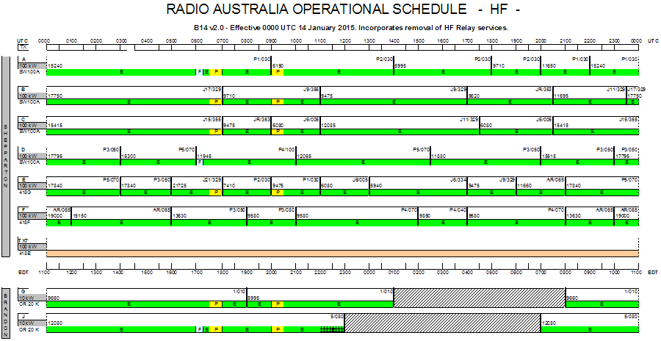
Radio Australia
Current Shortwave Services – continued
Schedule for B14

Slide 10
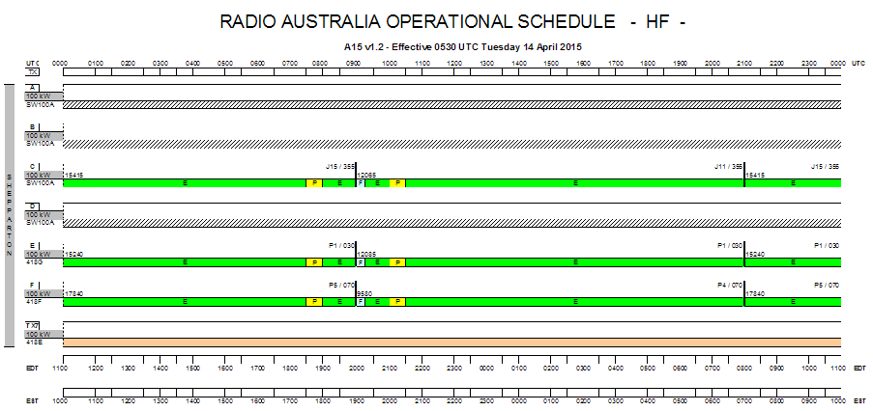
Radio Australia
Current Shortwave Services – continued
Schedule for A15

Slide 11
Radio Australia
Current Shortwave Services - continued
The recent changes have meant;
  Propagation performance is not optimal as there are only 2 x frequency changes per day; and
  The resulting schedule is difficult to coordinate.

Slide 12
Radio Australia
Questions?

