Slide 1






MARKETS - A Snapshot

Slide 2
DRM adopts the xHE-AAC Audio Codec
Digital Radio Mondiale (DRM) is the first global broadcast standard to embrace the Extended HE-AAC codec (Sept. 2013)
• First MPEG audio codec to combine speech and general-purpose audio coding in a unified system
• Allows high quality delivery of any type of audio content at virtually any bit rate
• Makes DRM one of the strongest digital options
• For sound samples, please visit:
http://www.drm.org/wp-content/uploads/2013/09/DRM-xHE-AAC-Demo_v2_20130913.avi
• ETSI new specification ES 20/980 V4.1.1 (2014.01) http://www.drm.org/?p=2762
(http://www.drm.org/wp-content/uploads/2014/01/DRM-System-Specification-ETSI-ES-201-980-V4.1.1-2014-01.pdf)

Slide 3
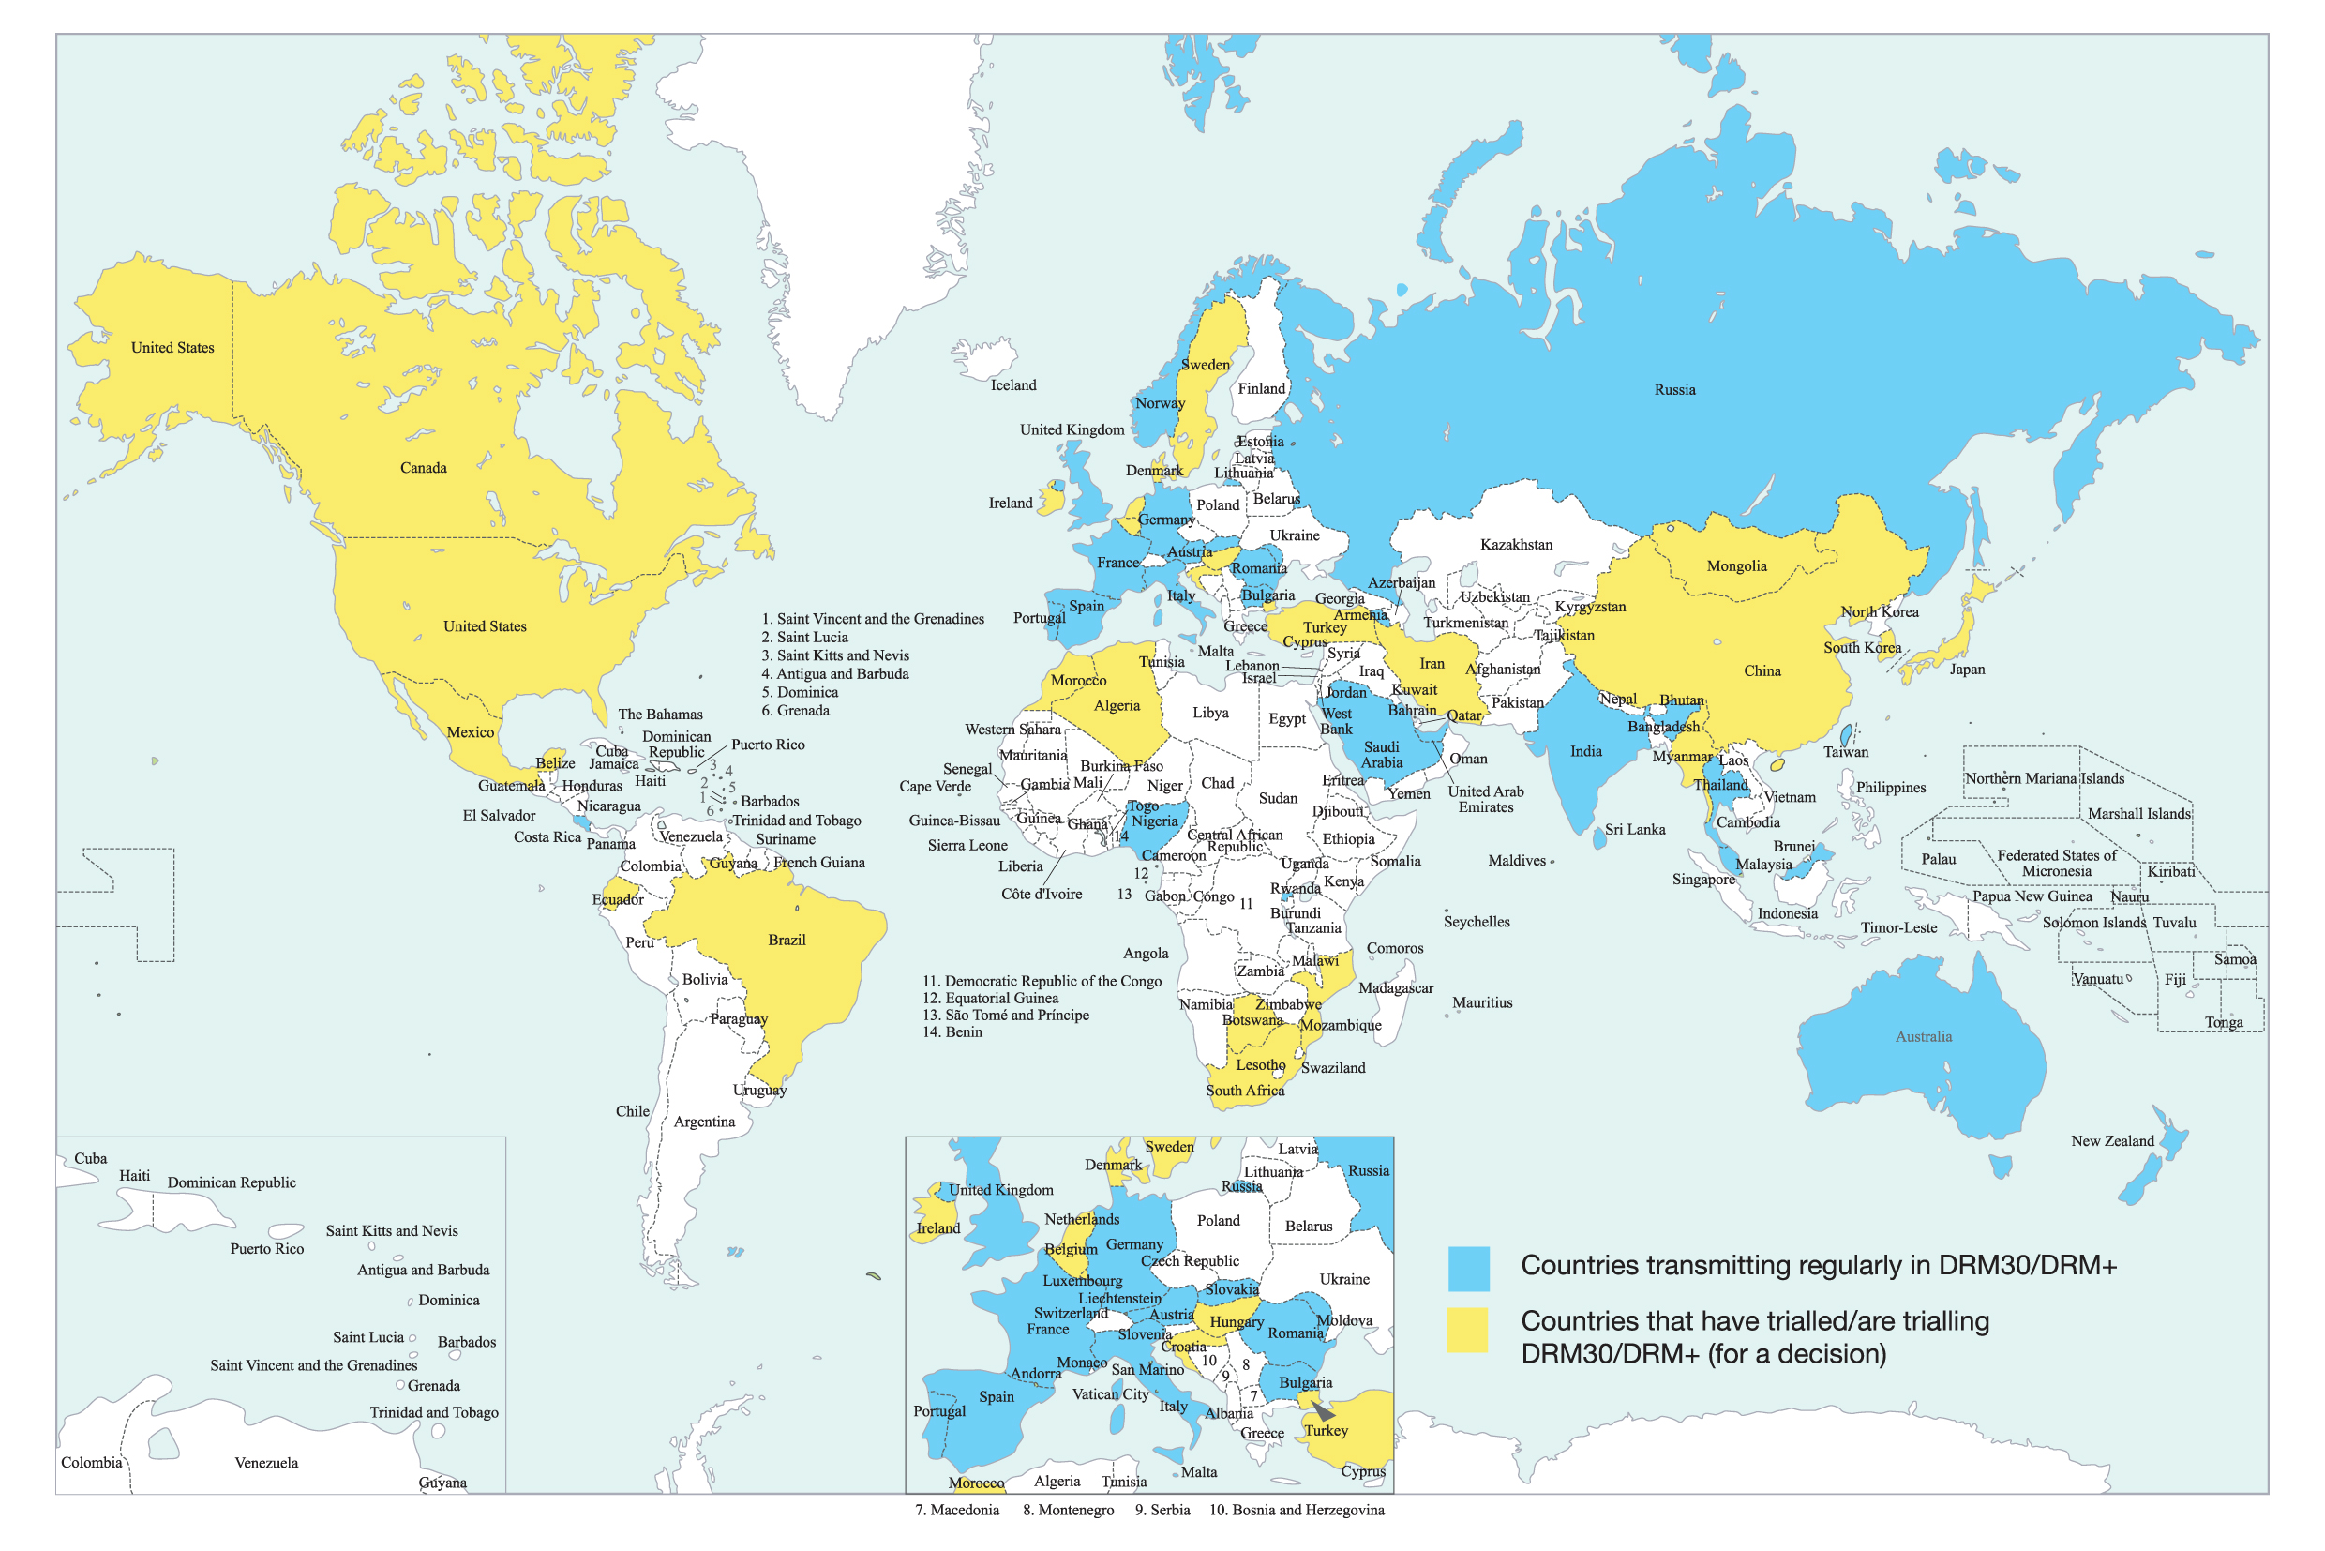
DRM Broadcasts and Trials in the World

Slide 4

DRM Key Markets
Russia
Brazil
India
Africa

Slide 5
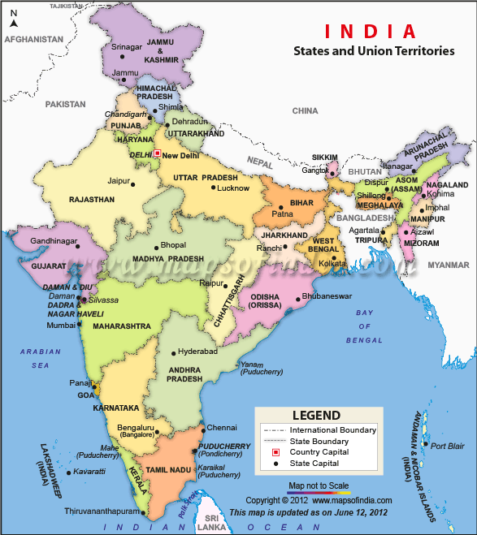
India
Population – 1.2 Billion
Public Service Broadcaster - All India Radio
Domestic Coverage – Almost 100%
External Services – 72 Hrs/day in 27 Languages (15 Foreign & 12 Indian)
Private FM Broadcasters – 245 Stations
Coverage – About 30%
Expansion Planned – 839 Stations
Community Radio Stations - 167
Internet Users – Over 220 Million
Transmitters – 574
MW – 144, SW – 48 & FM - 382

Slide 6


Brazil
EBC (Public broadcaster) to test SW DRM for Amazon region (March 2015)
Only SW and MW can reach the Amazon and Brazil rural zones
DRM can bring to those populations the content and all the benefits of digital radio

Slide 7
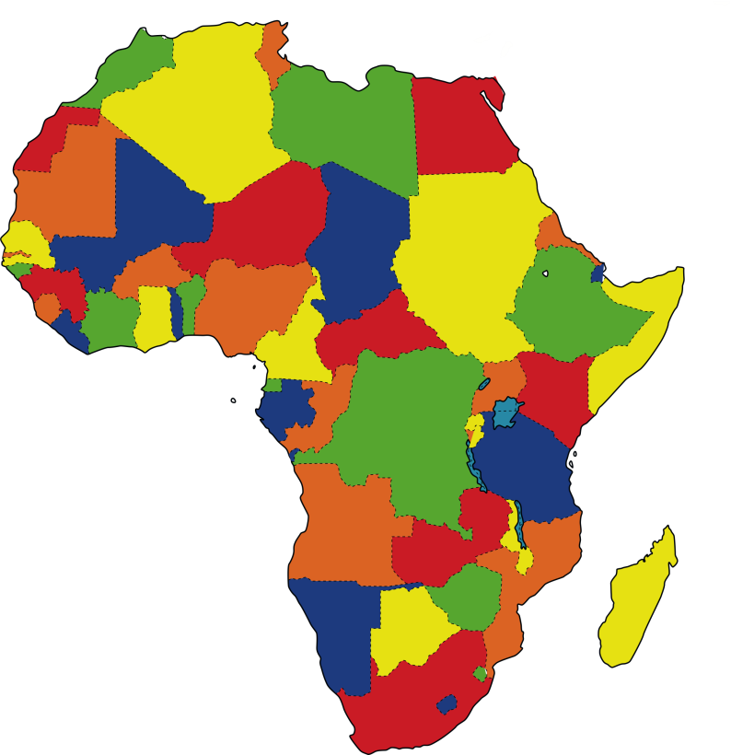
Africa
• Significant interest in DRM in Southern Africa in last 2 years
• DRM30 tests started or in preparation in several countries
• SW DRM transmissions in October 2011, July 2013, April 2014
• DRM Consortium attends regularly major SABA events (2013 – 2014)
• Increasing African countries attracted to DRM broadcasting benefits
(such as Mozambique, Botswana, Zambia)
• Nigeria adopted DRM and is broadcasting for abroad from Abuja
since March 2012 with increased DRM output since May 2014
• Mozambique (adopted DRM), Zambia, Botswana, (Tanzania) showing great interest
• Algeria adopted DRM and installed transmitters in 2013

Slide 8
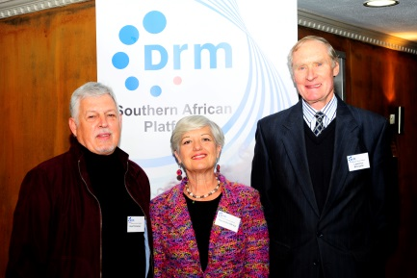

Southern Africa
• Launch of the DRM Southern Africa Platform in Pretoria in June 2014
to promote DRM across Southern Africa http://www.drmsa.org/
• Radio Pulpit has made history by leading the South African radio
broadcasting industry into the digital era with the first LIVE
digital medium wave broadcast in South Africa
• DRM30 (MW) test launched in July 2014 in Pretoria and part of
Johannesburg
• Car industry, receiver and equipment manufacturers show interest

Slide 9

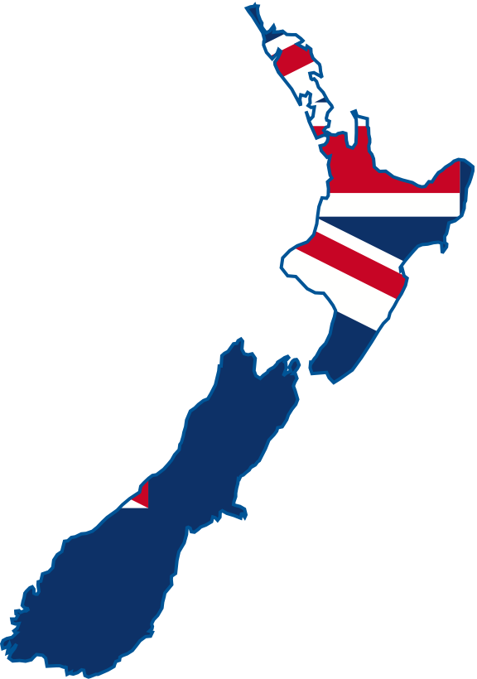
New Zealand
• Radio New Zealand International installed a 100 kW DRM shortwave
transmitter, which broadcasts 20 hours per day in DRM
• Used primarily to *distribute to the outer Pacific islands.
* PCJ Radio International distributing audio using DRM to two stations in Cambodia

Slide 10


Bangladesh
• Bangladesh installed a 250 kW short wave transmitter
and antenna
• Barisal station of BETAR (public broadcaster) has a new DRM
compatible 20 kW transmitter
• 1000kW medium wave Transmitter DRM ready, commissioned
and in operation at Dhamrai for BETAR since early July 2011
• An order from BETAR for 3 units 100kW medium wave transmitters
including DRM equipment is currently processed. Operation will
start at Chittagong (1x 100kW) and Savar station (2x 100kW) in
2015

Slide 11

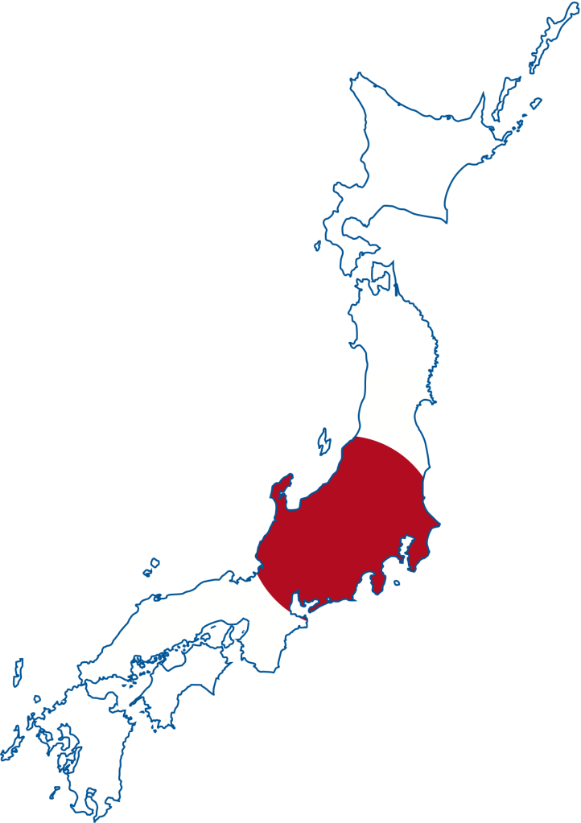
Japan – DRM Upgrade
• Japan acquired four x 300kW short wave Transmitters
• First new Transmitter went on-air in April 2013
• Three more planned at yearly:
2014-01 Transmitter 2 delivered and in operation
2014-08 Transmitter 3 delivered and setup in operation
2015-08 Transmitter 4 to be delivered and accepted
• All Transmitters are fully DRM equipped and tested in factory
• National decision to reinvest in DRM SW primarily after
national disasters.

Slide 12


Taiwan
• World‘s biggest shortwave modernisation project under execution
• 2013/2014: RTI Radio Taiwan International upgrades two radio
transmission sites with the DRM system:
- Station 1 with 4 Transmitters x 300kW in operation
- Station 2 with 6 Transmitters x 300kW delivered on site
(installation and acceptance ongoing and operation ready by Q1-2015)
- All 10 Transmitters are DRM ready and factory tested.
• 2005: Cheng Sheng Broadcasting Corporation (CSBC)
launched a DRM system to provide digital radio broadcasts
throughout Taipei and the surrounding areas
• CSBC was first to broadcast with the DRM standard in Taiwan

Slide 13


Kingdom of Saudi Arabia
• The Saudi Broadcasting Corporation has adopted the
DRM digital standard for MW and SW
• MW Transmission stations are located in Gazan, Taiba,
Hafr Elbatin, Abha
• Current Projects: in Afif, in Layla ( Al-aflag ), in Duba and Riyadh

Slide 14

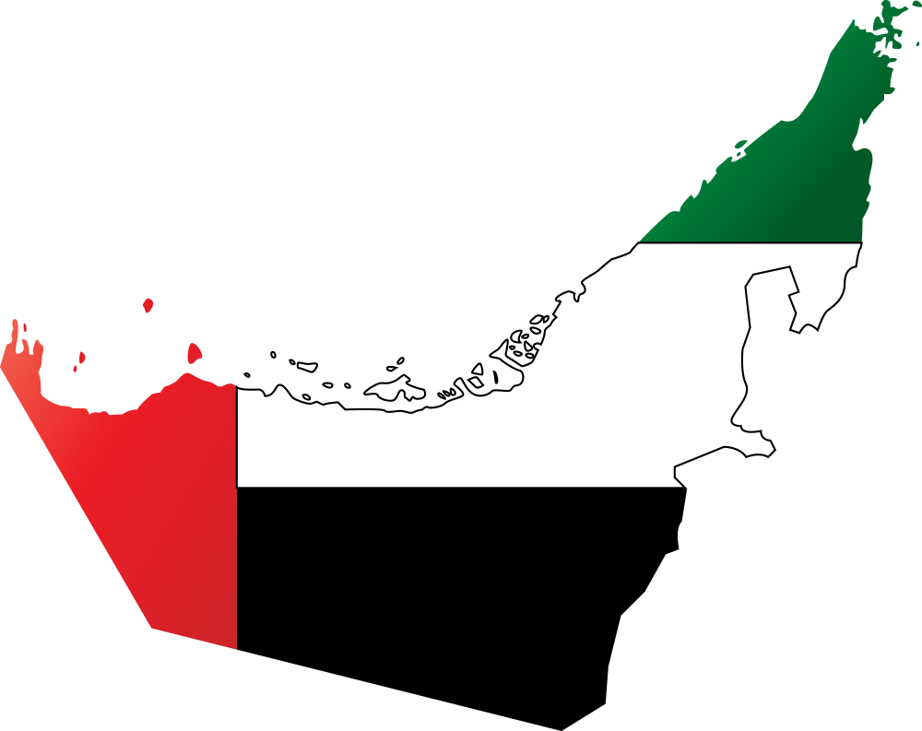
United Arab Emirates
• 17th Dec 2013: launch of the world’s first Malayalam digital radio on UAE airwaves
• The channel, Pravasi Bharathi 810 AM, Malayalam Digital Radio
(DRM), aims to reach out to millions of listeners streaming music,
discussions, news, current affairs and entertainment
• Reaching all Golf Cooperation Council nations
with excellent DRM:
• like FM quality in digital radios
• and super AM quality in ordinary receivers

Slide 15


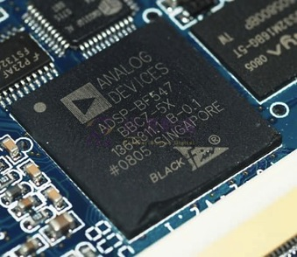






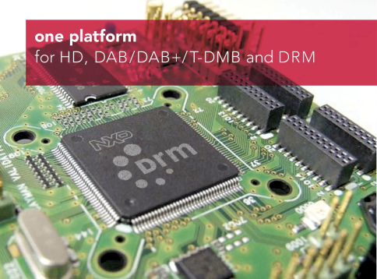




DRM Chipsets
DiBcom

Slide 16



Multi-standard Chipsets with DRM
Dec 2013: Frontier Silicon announces details of its multi-standard chipset with DRM
http://www.frontier-silicon.com/new-digital-radio-chip-targets-smart-devices-and-global-markets
Feb 2014: Siano launches Advanced Multi-Standard Digital Radio Receiver Chip Supporting T-DMB/DAB/DAB+, DRM+ and Legacy FM Radio - Targeting automotive and portable/mobile devices
http://www.siano-ms.com/index.php/news/press-releases/261-siano-launches-advanced-multi-standard-digital-radio-receiver-chip-supporting-t-dmb-dab-dab-drm-and-legacy-fm-radio

Slide 17

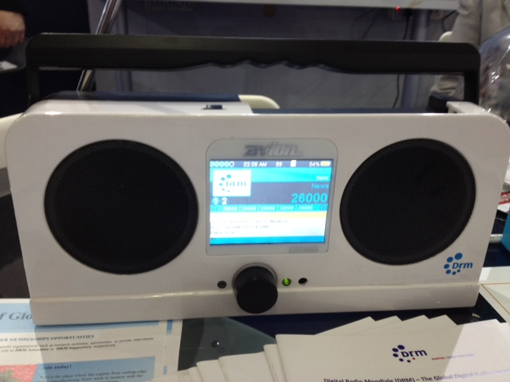
DRM Receivers
• The Indian market and All India Radio’s official commitment to DRM have
stimulated local radio manufacturers to plan their production of receivers
• Discussions with car radio, mobile phone and desktop radio manufacturers are
taking place
• Broadcast audio on platforms – not just radios!
AV DR1401
Full DRM feature set

Slide 18
DRM Membership Benefits
Privileged Information
• Receive general and extra information alongside the monthly DRM and Indian Newsletters
• Enjoy access to the ftp server where members only documents on the latest DRM developments are posted
Marketing and PR Support
• Use the DRM logo, have your own company logo and products on the DRM Website
• Get the support of the DRM Project Office for related DRM communication and events
• Get exclusive give-aways, DRM marketing support and exhibition kits
Networking Opportunities
• Get the best B2B platform to meet and build contacts related to the DRM business
• Enjoy a presence at big international media events and represent both the Consortium and your own companies
For more information contact: projectoffice@drm.org

Slide 19










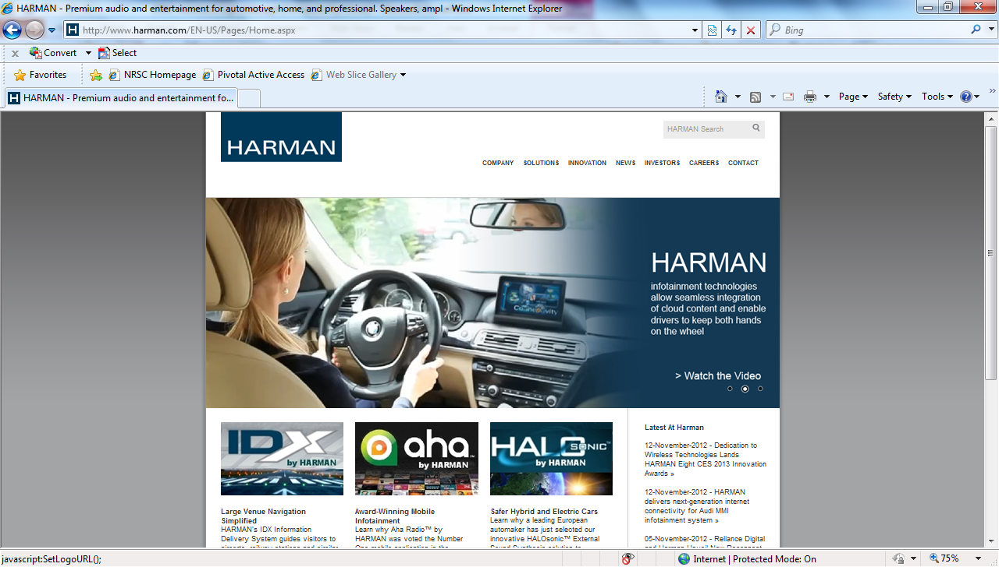




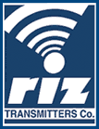




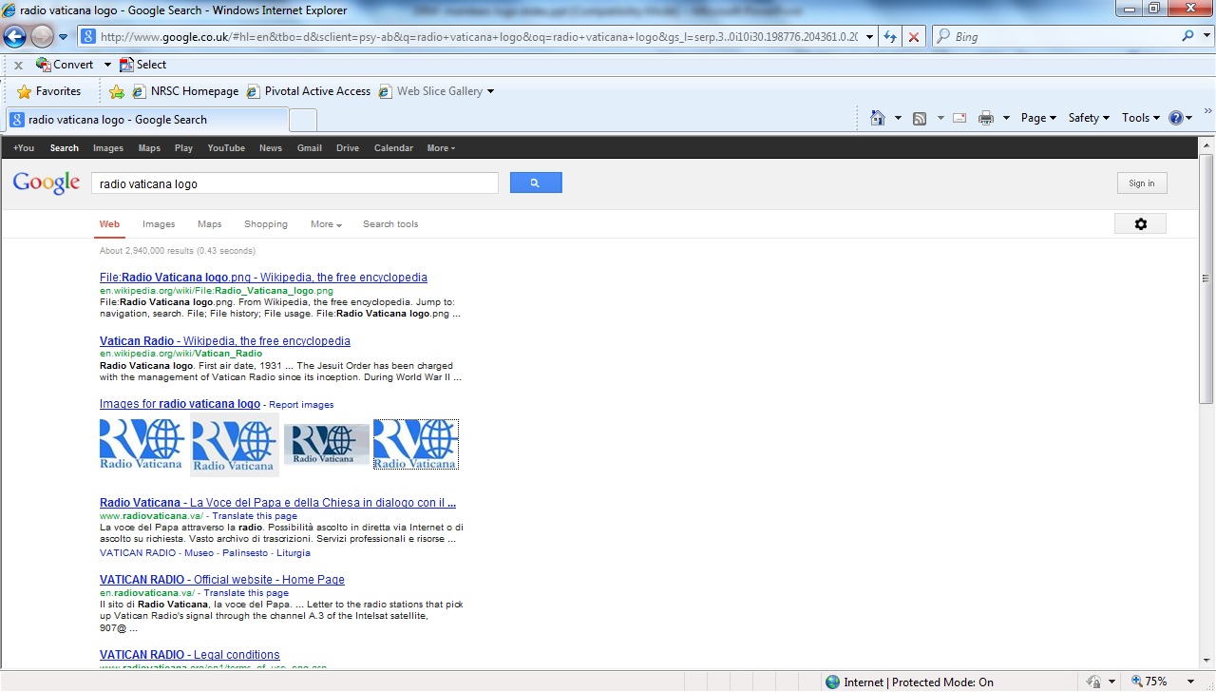
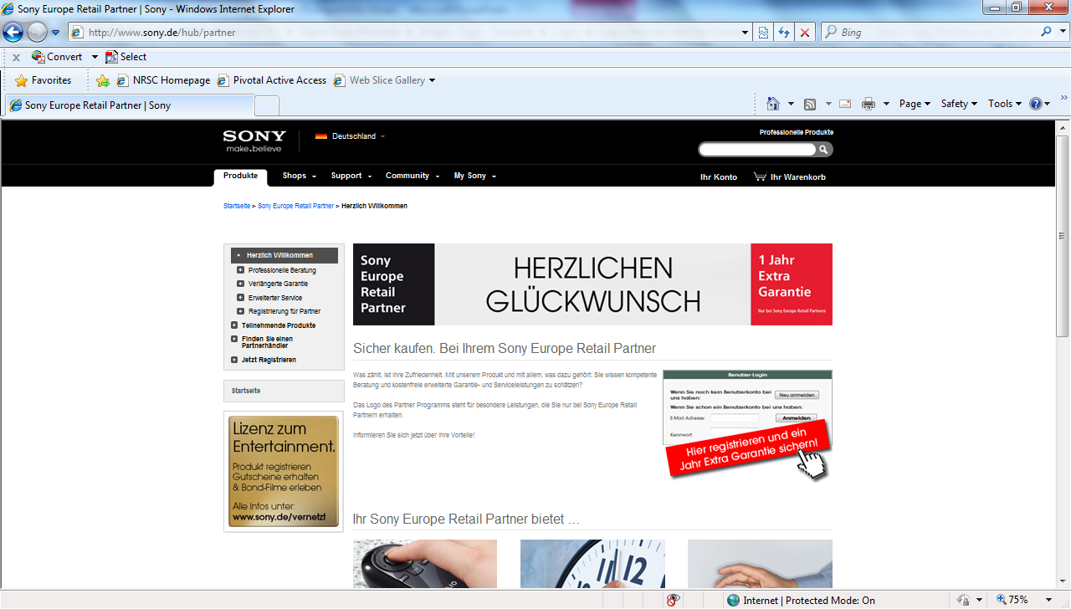

Selection of DRM Consortium Members
The not-for-profit DRM Consortium
supports and promotes the DRM Standard and its take-up globally

Slide 20







More Information
Thank you!
www.drm.org
For free monthly DRM updates
visit and subscribe to:
www.drm.org/newsletters
For any inquiries or comments write to:
projectoffice@drm.org
@drmdigitalradio
DRM Introduction and Implementation Guide (DIG)
Download from: www.drm.org

