Slide 1
SHORT WAVE SERVICES:
The Gateway to Africa
August 2012

Slide 2
OVERVIEW
INTRODUCTION
SENTECH OVERVIEW
MARKET OUTLOOK
SENTECH SHORTWAVE SERVICE OFFERING
WHY USE SENTECH?

Slide 3
SENTECH:
Introduction
Sentech is a South African State Owned Company (SOC) operating in the broadcasting signal distribution and telecommunications sector.
Sentech is responsible for the development and operation of a vital infrastructure which provides broadcasting, wireless broadband and managed services to a wide range of customers.
The company currently owns and operate 742 FM radio transmitters, 627 television transmitters and satellite services.
The infrastructure carries transmission signals for the public broadcaster as well as commercial and community broadcasters
Broadcasting & Media
Terrestrial TV
Telecommunication Services
Other Services
Facility Rental
VSAT
Wireless Broadband
Terrestrial Radio
Free To Air Satellite TV & Radio
Business TV & Radio
Content Management Solutions
Training
Consulting

Slide 4

SHORT WAVE IN AFRICA:
Outlook
    Africa Shortwave Opportunities
    The nature of the SW frequency is that is able to travel long distances and over multiple territorial borders thus reaching a larger audience coverage area making it ideal for Africa
    SW is also suitable because many countries on the continent have limited resources and infrastructure for broadcasting
    In some cases there is also restricted freedom of speech
    In times of Emergencies and Humanitarian Crisis situations shortwave is a technology solution of choice .

Slide 5
SHORT WAVE IN AFRICA:
Outlook
    Africa Shortwave Opportunities
  Compared to the rest of the world Africa’s communication infrastructure is lagging behind with:
    Limited FM Radio coverage
    Limited Television coverage
    Limited to no Internet coverage
  Up to 30% of countries in Africa listen to Shortwave
  TWR Survey In Swaziland – To determine if people were still listening. Listeners responded overwhelming via SMS, E-mail, Phone Calls and Letters. Feedback from listeners was that TWR should keep broadcasting on SW
  There is a strong value proposition for Shortwave broadcasting in Africa due to the low penetration of other forms of terrestrial broadcasting

Slide 6
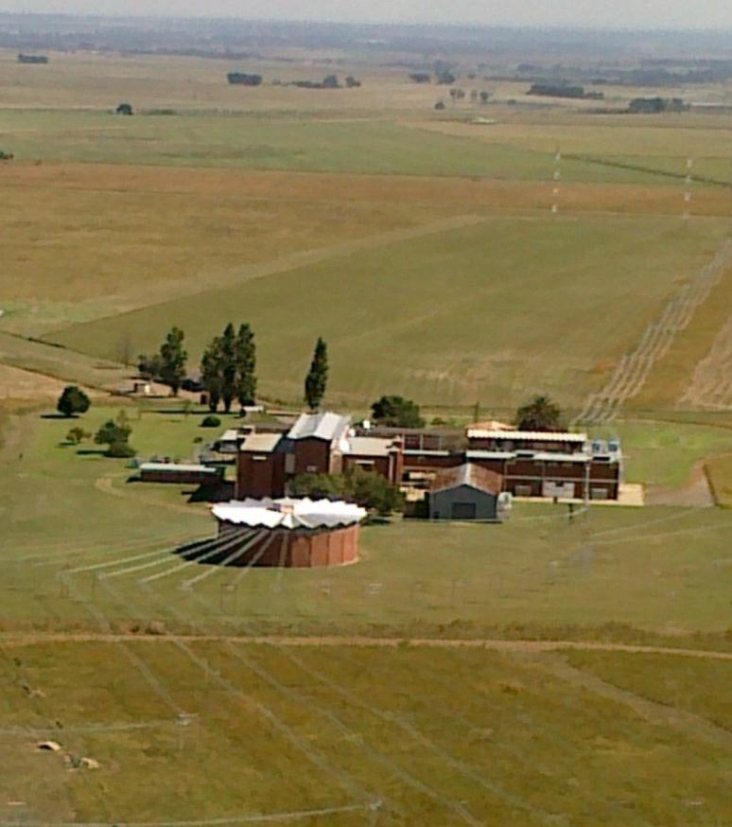
SENTECH SHORT WAVE SERVICES:
Overview
Transmission Site
Approximately 80km from Johannesburg, the economic hub of the region, lies Sentech’s Shortwave Transmission Site - Meyerton
Built in 1964, the facility is a well maintained SW transmission second to none on the continent
The facility has a staff complement of well trained personnel that support SW transmissions to the continent and beyond

Slide 7
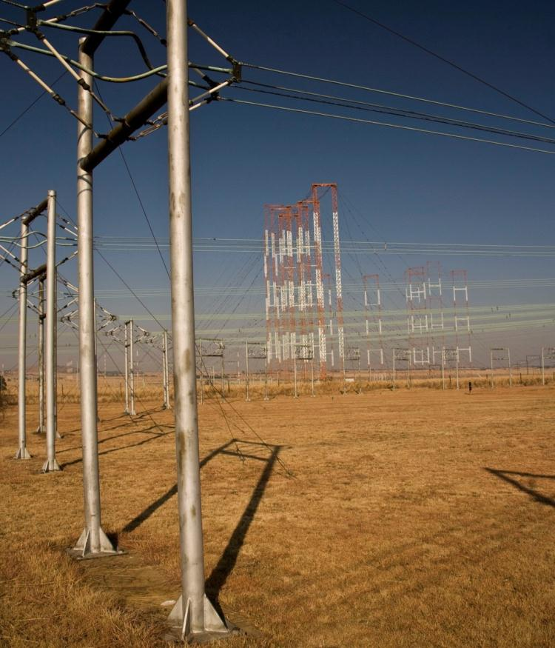
SENTECH SHORT WAVE SERVICES:
Infrastructure
Short Wave Infrastructure
  16 SW transmitters
  10 x 100 kW transmitters
  4 x 250 kW transmitters
  2 x 500 kW transmitters
43 Antennas
    34 x Curtain Arrays (Africa and Mid East)
    9 Periodic Arrays (Parts of Southern Africa)

Slide 8
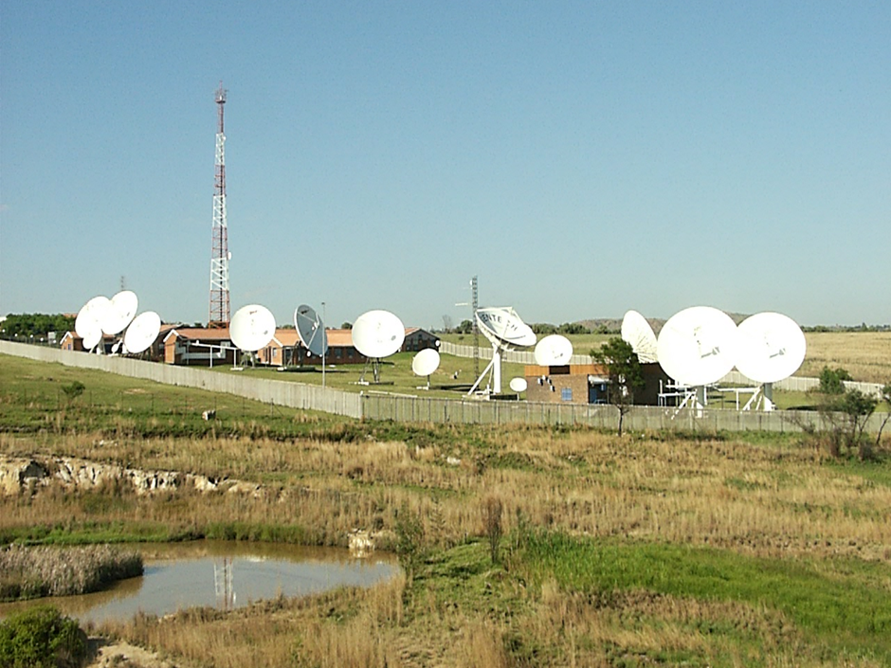
SENTECH SHORT WAVE SERVICES:
Linking
Sentech can receive the programs from all over the world using our extensive linking infrastructure including:
Satellite (C-band and Ku-band)
  Ku- band - 5 x 36 MHZ Transponders
  C-band – 1 x 72 MHZ Transponders
Digital leased lines
  Managed third party Point to Point Links
Microwave links
  Deployed in Core Broadcast Network
STL RF links (Studio to Transmitter)
  Contribution Feed for Commercial
  Community broadcasters

Slide 9

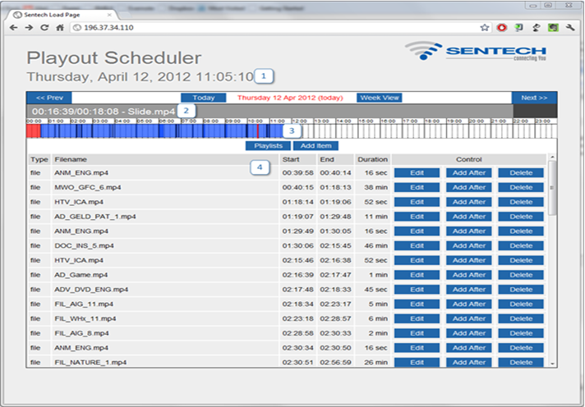
SENTECH SHORT WAVE SERVICES:
FTP Playout
Sentech has recently developed our own custom ftp playout service
The Meyerton station now has high speed internet access which enables reception of FTP files for local playout of programs.
The Playout Service consists of 3 Components:
Content Storage
Scheduling
Playout Service
Each customer gets has their own interface that will allow them to manage their own channels.
9

Slide 10
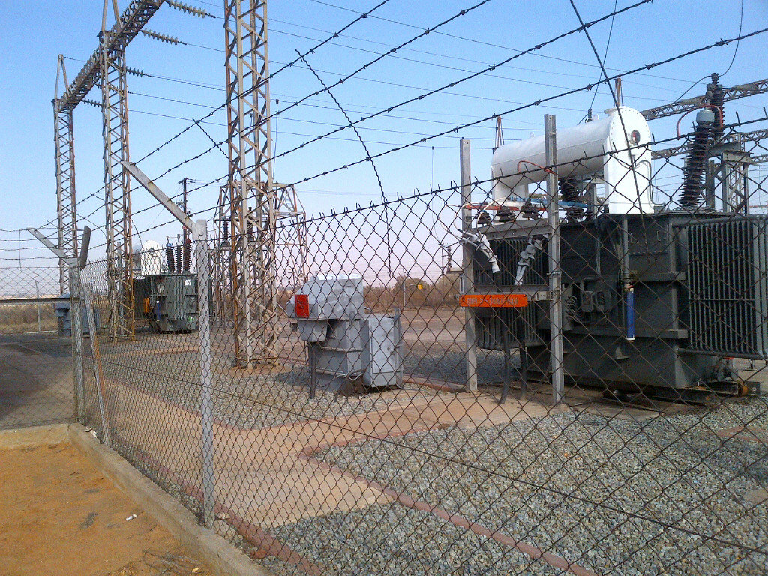
SENTECH SHORT WAVE SERVICES:
Power
Easily Accessible Sub Station
Step down from 88 kV to 11 kV
Ring Fed from alternative generation sources
Back up cables between substation & both transmitter sites

Slide 11






SENTECH SHORT WAVE SERVICES:
Customers
Broadcast Hours
3300 hours per month
Customer Base
23 Short Wave Broadcasters

Slide 12

SENTECH SHORT WAVE SERVICES:
Why Sentech
Technical Support
  20/7 manned SW station
  24/7 NOC
  SLA to 3rd level support
  +99.5% transmitter availability
  45 highly trained staff at Meyerton
Advantages
  Coverage of Africa & Middle East
  Proven Track Record
  Excellent Customer Service
  Multiple Linking Options
  FTP Playout Services
  Competitive Hourly Rates

Slide 13
Sentech Head Office
+27 11 4714400
www.sentech.co.za
Allistair Oliver
Tel: +27 21 551 9853
Cell: +27 84 248 1156
E-mail: olivera@sentech.co.za
www.sentech.co.za

